Slide 1
Preparation graduationreport
RaymondBlankestijn& Elleke Jagersma
January2023

Slide 2
Content
Blackboard
Visiongraduation
How doyoustart?
Research
Parts of the report and accompanying documents
Otherrequirements
Common mistakes

Slide 3
Blackboard
Beforegraduating:
Checklistgraduation
Approvalofassignmentet cetera.
Visiongraduation
 | Bachelor
General: | Requirements: Propedeuse and at least 147 EC from main phase.These results must be registered on Progress. The course written communication 2 is a compulsory part and must have been passed before graduation. The graduation agency carries out this check on behalf of the examination committee.
Approve graduation project: | By graduation agency.
Signed graduation project agreement: | NHL-Stenden graduation project agreement. Three copies for and signed by student, company supervisor andteamleader(Niels Doorn). The copy for NHL-Stenden must be a digital copy and must be sent to theteamleader.

Slide 4
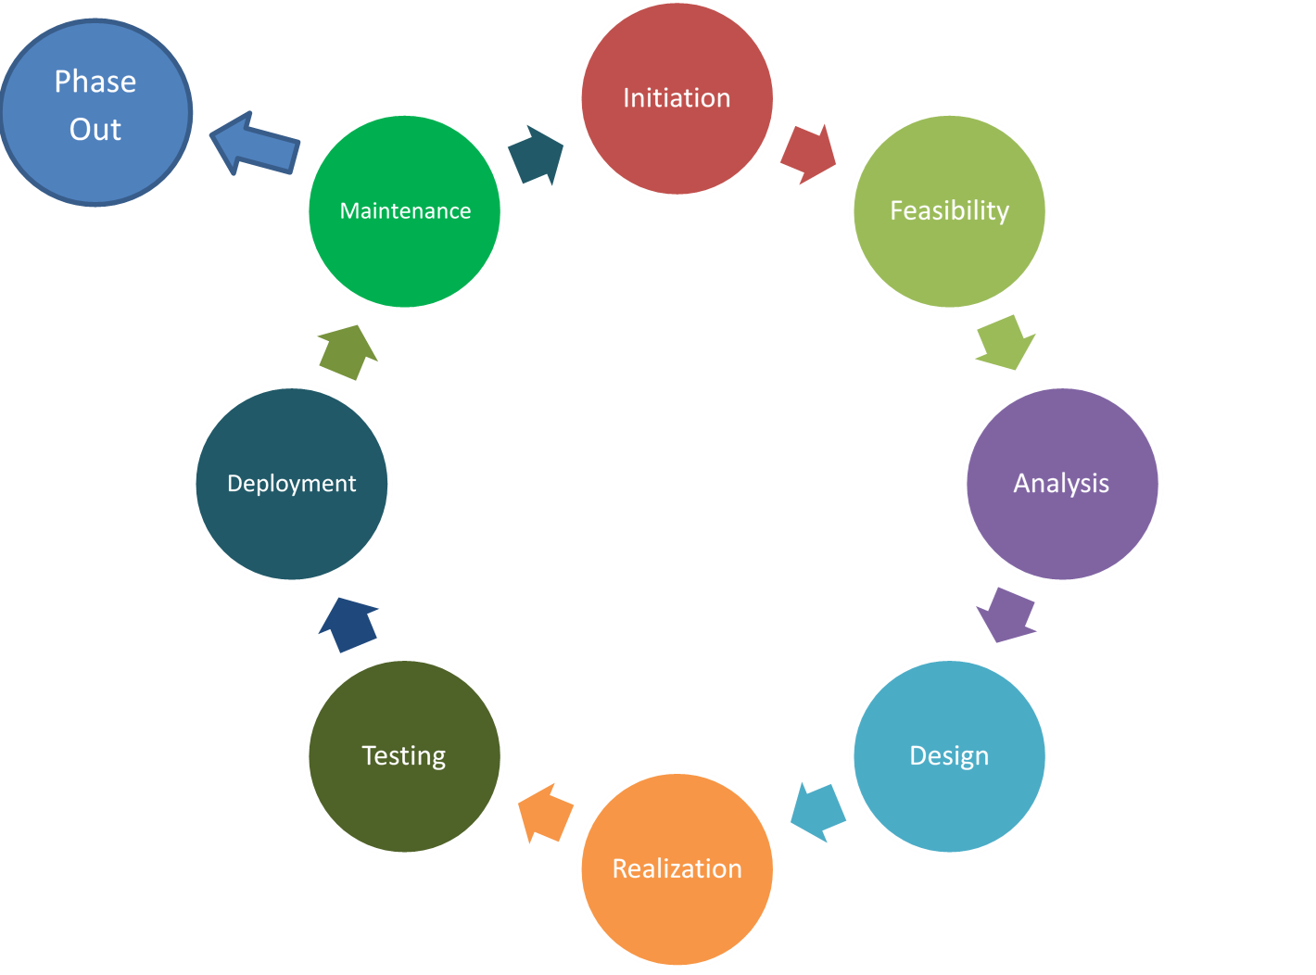
Visiongraduation
The Software Development Life Cycle (SDLC) below is to be used when graduating

Slide 5


Regularproject
Software and/or hardware is developed in these projects.

Slide 6
graduationreport
Maintext
The research
The process
The product
Appendices
Original graduation project description *
Project plan (including schedule) *
FD/SRS/PRS is to be included in an appendix

Slide 7


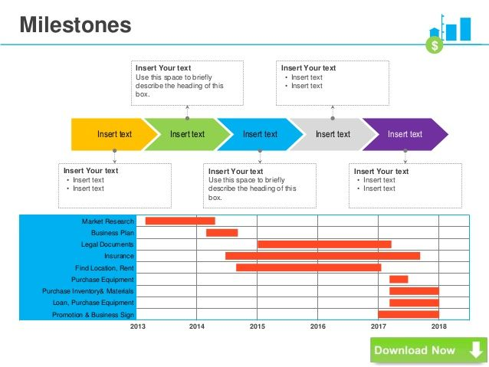
How doyoustart?
Project plan

Slide 8
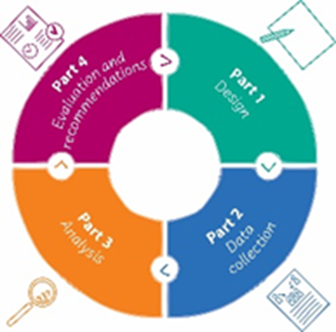
Research
Central question
Method
reliability
Validity
Conclusion
Discussion
Usability

Slide 9
The structure of the report
1. Front page
2. English summary
3.Tableof contents
4. Generalintroduction(includingdescriptionofthecompany)
5.Objective,problemdefinition, etc.
6. Research
7.Realisation/Results
8.Discussionandconclusions
9. Suggestions for further research
10. Evaluationandreflection(separate document)
11.Literature
12. Appendices

Slide 10
Otherrequirements
Write formally
substructureandrefer(APA)
Think about the rules of tables and figures
Pay attention to spelling, style and grammar rules
Be consistent in structure and layout
Every item of the grading form mustbe in the report

Slide 11
Most made mistakes
Languageandspellingerrors
Summary is not a summary but a reading guide. Or the summary can not be read separately
Inconsistent story
Bad research;too little substantiation of the research
Difference between Waterfall method and Agile.
Conclusion can not be read separately / central question is not repeated and if it is answered.
The conclusion must be focused on sub-questions and broad lines. Not a complete summary
Paragraph use (use of headings)
Lay-out.Chapter ordering, headers and footers
Good balance images and text.

Slide 12
Examplegoodreport

Slide 13



